Slide 1
Making a Mesh of the Infrastructure
Pete Brown
Network Engineer, AutoZone
@jpbrown1

Slide 2

Pete has supported various functional areas of infrastructure for around 20 years. He is a proponent of democratizing access to infrastructure data in order to promote learning, facilitate better decision making and reduce reliance on tribal knowledge.

Slide 3
Agenda
The Challenge
Infrastructure Sources
Traditional Integration
Mesh Integration
Demo
Cultural Impact
Q&A

Slide 4
The Challenge
We are often asked to collect and analyze data from disparate infrastructure source types. These efforts are hindered by constant technological and environmental changes.
How can we mitigate the impact of these changes to reduce time spent on development and maintenance?

Slide 5
Infrastructure Sources
Buy infrastructure products to fulfill the needs of the business
Buy tools to manage the infrastructure products
Write internal ad-hoc processes for analysis
Develop internal dashboards
Develop scheduled maintenance processes

Slide 6
Infrastructure Sources
Internal Dashboards
IPAM
Monitoring
Directory Services
CMDB
Telephony
Management Tools
Load Balancers
Ad-hoc processes
Maintenance Jobs

Slide 7















Infrastructure Sources
Directory Services
Network
InfoSec
Telephony

Slide 8

Infrastructure Sources
Directory Services
Hi! I need a list of Active Directory users.
Okay, here you go…

Slide 9

Infrastructure Sources
Directory Services

Slide 10

Accessing a Source – NO API
Directory Services
Telephony
(Your Python script)
Load Balancers

Slide 11
Sample sources
Source Type | Protocol | Data Format | Spec Format | Spec Source | Client Language
Meraki | REST | XML/JSON | OpenAPI | Application | any
CUCM – AXL/RIS | SOAP | XML | PDF/HTML | Application | any
CUCM - JTAPI | JTAPI | binary | PDF/HTML | Application | Java
CUC - CUPI | REST | XML | PDF/HTML | Internet | any
NetScaler | REST | JSON | PDF/HTML | Internet | any
Active Directory | LDAP | binary | PDF/HTML | Internet | any

Slide 12
Accessing a Source – DIRECT API
1
2
3
4
5
Study Integration Interface(s)
Implement Interface Libraries
Discover Instances
Acquire Credentials & Roles
Address Routing & Firewall Issues
Could be an API or native protocol (SQL, LDAP, etc)
Acquire or create language specific interface libraries
What instances are running in the environment? What versions are they running?
Work with service owners to acquire credentials & roles for each instance
Work with network and security groups to resolve any communication issues

Slide 13
Accessing a Source – DIRECT API
Directory Services
Telephony
(Your Python script)
Load Balancers

Slide 14
Infrastructure Sources
Internal Dashboards
IPAM
Monitoring
Directory Services
CMDB
Telephony
Management Tools
Load Balancers
Ad-hoc processes
Maintenance Jobs

Slide 15
Q. How do we make it easier to discover and integrate with sources?
A. Make services declare themselves and advertise their resources!

Slide 16

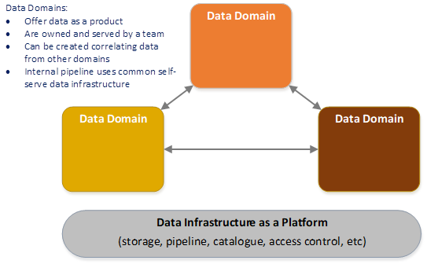
Data mesh
Infrastructure data sources should be:
Discoverable
Addressable
Trustworthy
Self-Describing
Interoperable
Secure
https://martinfowler.com/articles/data-monolith-to-mesh.html

Slide 17
DRP – Declarative Resource Protocol
A JSON based WebSocket subprotocol for declaring and consuming resources
Provides a relatively easy way to create a service mesh for the infrastructure
Allows consumers to focus on data analysis functions by reducing time spent on discovery and connectivity
Promotes an integrate once, use many approach

Slide 18
DRP – Declarative Resource Protocol
Sources are declared, not discovered
Sources use a common format for declarations
Consumers use a single logical endpoint to access all sources
Consumers use a standardized RPC & pub/sub mechanism to access all sources

Slide 19
DRP – roles
Acts as control plane
Meshes with other Registries via DNS SRV records
Routes traffic between non-listening nodes
Declares services to mesh
Can be listening or non-listening
Services consist of methods, classes and streams
Registry
Any client (web browser, script, etc)
Makes requests via REST or WebSockets
Provider
Broker
Registry
Native
Consumer
Provider
Native
Any non-DRP capable backend service
Requires a DRP Provider to interact with mesh
Processes requests from Consumers
Logger
Logger
Broker
Consumer
Accepts logs from other Nodes
Writes logs to DB

Slide 20
DRP – Multiple Zone example
Zone A
Zone B
https://zone-a.acme.com
https://zone-b.acme.com
Load Balancer
Load Balancer
Registry
Provider
Native
Logger
Broker
Consumer
_drp._tcp.acme.com. 600 IN SRV 10 10 443 registry1.acme.com.
_drp._tcp.acme.com. 600 IN SRV 10 10 443 registry2.acme.com.
_drp._tcp.acme.com. 600 IN SRV 10 10 443 registry3.acme.com.
_drp._tcp.acme.com. 600 IN SRV 10 10 443 registry4.acme.com.

Slide 21
Accessing a Source – DIRECT API
Directory Services
Registry
Telephony
(Your Python script)
Provider
Load Balancers
Native
Logger
Broker
Consumer

Slide 22
Accessing a Source - MESH
Directory Services
Web Client
Registry
Telephony
(Your Python script)
Provider
Load Balancers
PowerShell
Native
Logger
Logger
Broker
Consumer

Slide 23
Accessing a Source - MESH
1
2
3
4
5
Study Integration Interface(s)
Implement Interface Libraries
Discover Instances
Acquire Credentials & Roles
Address Routing & Firewall Issues
Could be an API or native protocol (SQL, LDAP, etc)
Acquire or create language specific interface libraries
What instances are running in the environment? What versions are they running?
Work with service owners to acquire credentials & roles for each instance
Work with network and security groups to resolve any communication issues

Slide 24
Infrastructure Sources
X
Directory Services

Slide 25
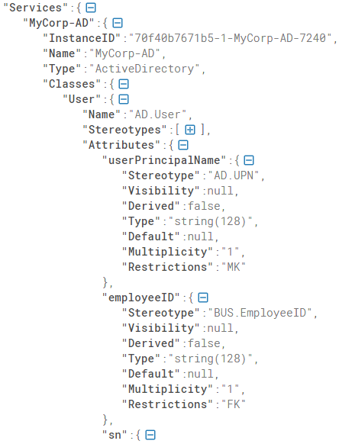
Infrastructure Sources
Directory Services

Slide 26
Infrastructure Sources
Directory Services
Network
DRP MESH
InfoSec
Telephony

Slide 27
Demo Time

Slide 28
Closing thought
If groups within an organization are to operate as a cohesive unit, internal data sharing practices need to reflect that!

Slide 29
Q & A
Project used in demo:
https://github.com/adhdtech/DRP

